Slide 1
Advanced Features : Sparse Arrays, Cell Arrays, Structures, and Function Handles

Slide 2


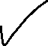
Outline
Sparse Arrays
Cell Arrays
Structure Arrays
Function Handle

Slide 3
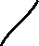
Sparse Array
Syntax :
sparseMatrixVariable = sparse(variable)
MATLAB creates a memory location for every element in the array
For example, the function a = eye(10) creates 100 elements arranged as a 10 x 10 structure. In this array, 90 of those elements are zero! This matrix requires 100 elements, but only 10 of them contain nonzero data. This is an example of a sparse array or sparse matrix.
A sparse matrix is a large matrix in which the vast majority of the elements are zero.

Slide 4
Command Window
>> a = eye(5)
a =
1 0 0 0 0
0 1 0 0 0
0 0 1 0 0
0 0 0 1 0
0 0 0 0 1
>> aSparse = sparse(a)
aSparse =
(1,1) 1
(2,2) 1
(3,3) 1
(4,4) 1
(5,5) 1
>> whos
Name Size Bytes Class Attributes
a 5x5 200 double
aSparse 5x5 128 double sparse
>> %
>> % a have 25 elements so it requires 25*8 = 200 bytes
>> % aSparse have 10 non-zero elements, so
>> % 10 array indices occupying 4 bytes each
>> % 8 byte overhead
>> % it requires = 10*8 + 10*4 + 8 = 128 bytes
>> %
>> z = eye(10000);
>> zSparse = sparse(z);
>> whos
Name Size Bytes Class Attributes
z 10000x10000 800000000 double
zSparse 10000x10000 240008 double sparse

Slide 5

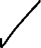
Sparse Array
Create Sparse Matrices | speye(row, col) | Create a sparse identity matrix
 | sprand(row) | Create a sparse uniformly distributed random matrix
 | sprandn(row) | Create a sparse normally distributed random matrix
Full to Sparse Conversion | sparse(var) | Convert a full matrix into a sparse matrix
 | full(var) | Convert a sparse matrix into a full matrix
 | find(element) | Find indices and values of nonzero elements in a matrix
Sparse Array Identification | issparse(var) | Returns true(1) when array is sparse

Slide 6






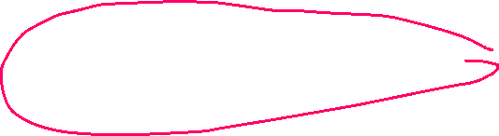
Sparse Array
Working with Sparse Matrices | nnz(var) | Number of nonzero matrix elements
 | nonzeros | Return a column vector containing the nonzero elements in a matrix
 | nzmax | Amount of storage allocated for nonzero matrix elements
 | spones | Replace nonzero sparse matrix elements with ones
 | Spalloc | Allocate space for a sparse matrix
 | spfun | Apply function to nonzero matrix elements
 | spy | Visualize sparsity pattern as a plot

Slide 7
Command Window
>> %
>> % Create Sparse Matrices
>> %
>> spEye = speye(3)
spEye =
(1,1) 1
(2,2) 1
(3,3) 1
>> spRand = sprand(3)
spRand =
(1,1) 0.2785
>> spRand = sprandn(3)
spRand =
(1,1) 0.34262
>> %
>> % Full to Sparse Conversion
>> %
>> a = eye(4)
a =
1 0 0 0
0 1 0 0
0 0 1 0
0 0 0 1
>> aSparse = sparse(a)
aSparse =
(1,1) 1
(2,2) 1
(3,3) 1
(4,4) 1

Slide 8
Command Window
>> [i,j,s] = find(aSparse)
i =
1
2
3
4
j =
1
2
3
4
s =
1
1
1
1
>> %
>> % Sparse Array Identification
>> %
>> issparse(aSparse)
ans =
logical
1
>> %
>> % Working with Sparse Matrices
>> %
>> aSparse(3,3) = 3
aSparse =
(1,1) 1
(2,2) 1
(3,3) 3
(4,4) 1

Slide 9
Command Window
>> aNnz = nnz(aSparse)
aNnz =
4
>> aNonzeros = nonzeros(aSparse)
aNonzeros =
1
1
3
1
>> aNzmax = nzmax(aSparse)
aNzmax =
4
>> aSpones = spones(aSparse)
aSpones =
(1,1) 1
(2,2) 1
(3,3) 1
(4,4) 1
>> aSpalloc = spalloc(3,4,3)
aSpalloc =
All zero sparse: 3×4
>> whos
Name Size Bytes Class Attributes
a 4x4 128 double
aNnz 1x1 8 double
aNonzeros 4x1 32 double
aNzmax 1x1 8 double
aSpalloc 3x4 88 double sparse
aSparse 4x4 104 double sparse
aSpones 4x4 104 double sparse

Slide 10
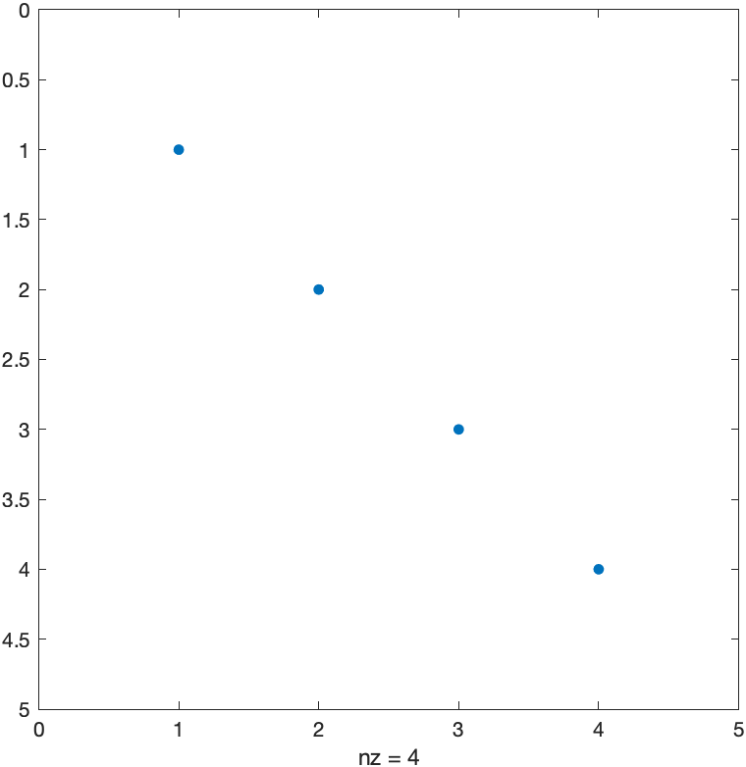
Command Window
>> aSpfun = spfun(@exp,aSparse)
aSpfun =
(1,1) 2.7183
(2,2) 2.7183
(3,3) 20.086
(4,4) 2.7183
>> spy(aSparse)

Slide 11
Cell Arrays
A cell array is a special MATLAB array whose elements are cells, containers that can hold other MATLAB arrays
cell array is a pointer to another data structure
Cell arrays use braces “{ }” instead of parentheses “( )” for selecting and displaying the contents of cells. This difference is due to the fact that cell arrays contain data structures instead of data

Slide 12
Sparse Array
cell(row, col) | Predefine a cell array structure
celldisp(var) | Display contents of a cell array
cellplot(var) | Plot structure of a cell array
cellstr(var/arg) | Convert a two-dimensional character array to a cell array of strings
char(var/arg) | Convert a cell array of strings into a two-dimensional character array ( also used for creating 2-D string array )

Slide 13

Cell Arrays
Cell arrays can be created in two ways :
By using assignment statements
By preallocating a cell array using the cell function
Command Window
>> a{1,1} = [1 3 -7; 2 0 6; 0 5 1];
>> a{1,2} = 'This is a text string';
>> a{2,1} = [3+4*i -5; -10*i 3-4*i];
>> a{2,2} = [];
>> a
a =
2×2 cell array
{3×3 double} {'This is a text string'}
{2×2 double} {0×0 double }
>> b(1,1) = {[1 3 -7; 2 0 6; 0 5 1]};
>> b(1,2) = {'This is a text string'};
>> b(2,1) = {[3+4*i -5; -10*i 3-4*i]};
>> b(2,2) = {[]}
b =
2×2 cell array
{3×3 double} {'This is a text string'}
{2×2 double} {0×0 double }

Slide 14








Cell Arrays
Cell 1,1 | Cell 1,2 'This is a text string'
Cell 2,1 | Cell 2,2 []
$$\left[\begin{matrix}1 & 3 & −7 \\ 2 & 0 & 6 \\ 0 & 5 & 1\end{matrix}\right]$$
a(1,1) | a(1,2)
a(2,1) | a(2,2)
$$\left[\begin{matrix}3+i4 & −5 \\ −i10 & 3−i4\end{matrix}\right]$$
[]
'This is a text string'
$$\left[\begin{matrix}1 & 3 & −7 \\ 2 & 0 & 6 \\ 0 & 5 & 1\end{matrix}\right]$$
$$\left[\begin{matrix}3+i4 & −5 \\ −i10 & 3−i4\end{matrix}\right]$$

Slide 15
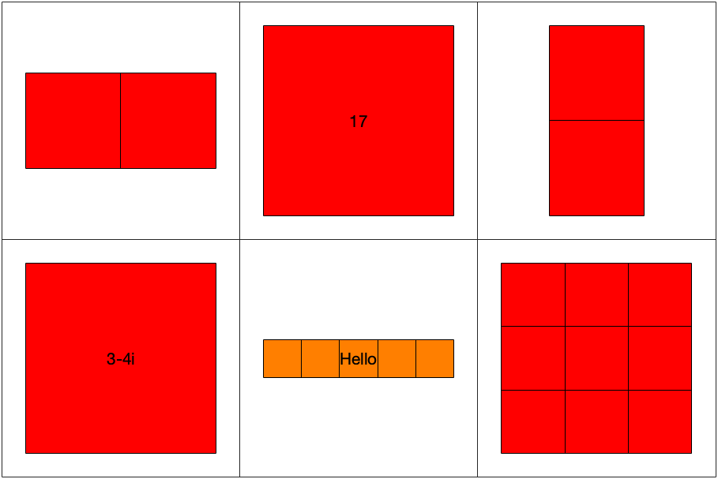
Command Window
>> c = cell(2,2)
c =
2×2 cell array
{0×0 double} {0×0 double}
{0×0 double} {0×0 double}
>> d = {[1 2], 17, [2;4]; 3-4*i, 'Hello', eye(3)}
d =
2×3 cell array
{1×2 double } {[ 17]} {2×1 double}
{[3 - 4i]} {'Hello'} {3×3 double}
>> %
>> % Viewing Content of a Cell Array
>> %
>> cellplot(d)

Slide 16
Command Window
>> celldisp(a)
a{1,1} =
1 3 -7
2 0 6
0 5 1
a{2,1} =
3 + 4i -5 + 0i
0 - 10i 3 - 4i
a{1,2} =
This is a text string
a{2,2} =
[]
>> %
>> % Extending Cell Array
>> %
>> a{3,3} = 5
a =
3×3 cell array
{3×3 double} {'This is a text string'} {0×0 double}
{2×2 double} {0×0 double } {0×0 double}
{0×0 double} {0×0 double } {[ 5]}

Slide 17


Cell Arrays
Cell 1,1 | Cell 1,2 'This is a text string' | Cell 1,3 []
Cell 2,1 | Cell 2,2 [] | Cell 2,3 []
Cell 3,1 [] | Cell 3,2 [] | Cell 3,3 [5]
$$\left[\begin{matrix}1 & 3 & −7 \\ 2 & 0 & 6 \\ 0 & 5 & 1\end{matrix}\right]$$
$$\left[\begin{matrix}3+i4 & −5 \\ −i10 & 3−i4\end{matrix}\right]$$

Slide 18


Command Window
>> %
>> % Deleting Cells in Array
>> %
>> a(3,:) = []
a =
2×3 cell array
{3×3 double} {'This is a text string'} {0×0 double}
{2×2 double} {0×0 double } {0×0 double}
>> %
>> % Using Data in Cell Array
>> %
>> e = {[1 2;3 4], 'dogs'; 'cats', i}
e =
2×2 cell array
{2×2 double} {'dogs' }
{'cats' } {[0 + 1i]}
>> e(1,1)
ans =
1×1 cell array
{2×2 double}
>> e{1,1}
ans =
1 2
3 4
>> e{2,1}
ans =
'cats'
>> e{1,1}(1,2)
ans =
2

Slide 19

Command Window
>> %
>> % Cell Array of Strings
>> %
>> cellstring{1} = 'Shubh Patel';
>> cellstring{2} = '18BCE171';
>> cellstring{3} = 'IND 999-88-777';
>> cellstring
cellstring =
1×3 cell array
{'Shubh Patel'} {'18BCE171'} {'IND 999-88-777’}
>> data = char('Shubh Patel','18BCE171')
data =
2×11 char array
'Shubh Patel'
'18BCE171 '
>> f = cellstr(data)
f =
2×1 cell array
{'Shubh Patel'}
{'18BCE171' }
>> newData = char(f)
newData =
2×11 char array
'Shubh Patel'
'18BCE171 '

Slide 20

test1.m
function test1(varargin)
disp(['There are ' int2str(nargin) ' arguments.']);
disp('The input arguments are:');
disp(varargin);
end
Command Window
>> %
>> % Significance of Cell Array
>> %
>> test1
There are 0 arguments.
The input arguments are:
>> test1(6)
There are 1 arguments.
The input arguments are:
{[6]}
>> test1(1,'test 1',[1 2;3 4])
There are 3 arguments.
The input arguments are:
{[1]} {'test 1'} {2×2 double}

Slide 21
Structure Arrays
Structure is a data type in which each individual element has a name.
Individual elements of a structure are known as fields, and each field in a structure may have a different type.
Individual fields are addressed by combining the name of the structure with the name of the field, separated by a period.
Structure array is an array of structures. Each structure in the array will have identically the same fields, but the data stored in each field can differ.
Example :
a class could be described by an array of the structure student. The first student’s name would be addressed as student(1).name, the second student’s city would be addressed as student(2).city, and so forth.

Slide 22
Structure Array
fieldnames(var) | Return a list of field names in a cell array of strings
getfield | Get current value from a field
rmfield | Remove a field from a structure array
setfield | Set new value into a field
struct | Pre-define a structure array

Slide 23
Structure Arrays
Structure arrays can be created in two ways :
A field at a time, using assignment statements
All at once, using the struct function
Command Window
>> student.name = 'Shubh Patel';
>> student.addr1 = 'B/G-1 Pushpraj-2';
>> student.city = 'Ahmedabad';
>> student.state = 'Gujarat';
>> student.zip = '380061';
>> student
student =
struct with fields:
name: 'Shubh Patel'
addr1: 'B/G-1 Pushpraj-2'
city: 'Ahmedabad'
state: 'Gujarat'
zip: '380061'

Slide 24

Structure Arrays
student
name
Shubh Patel
addr1
B/G-1 Pushpraj-2
city
Ahmedabad
state
Gujarat
zip
380061

Slide 25
Command Window
>> student(2).name = 'Poojan Patel'
student =
1×2 struct array with fields:
name
addr1
city
state
zip
>> student(1)
ans =
struct with fields:
name: 'Shubh Patel'
addr1: 'B/G-1 Pushpraj-2'
city: 'Ahmedabad'
state: 'Gujarat'
zip: '380061'
>> student(2)
ans =
struct with fields:
name: 'Poojan Patel'
addr1: []
city: []
state: []
zip: []
>> teacher(10) = struct('name',[],'addr1',[],'city',[],'state',[],'zip',[])
teacher =
1×10 struct array with fields:
name
addr1
city
state
zip

Slide 26
Command Window
>> %
>> % Adding fields to Structures
>> %
>> student(2).exams = [90 82 88]
student =
1×2 struct array with fields:
name
addr1
city
state
zip
exams
>> student(1)
ans =
struct with fields:
name: 'Shubh Patel'
addr1: 'B/G-1 Pushpraj-2'
city: 'Ahmedabad'
state: 'Gujarat'
zip: '380061'
exams: []
>> student(2)
ans =
struct with fields:
name: 'Poojan Patel'
addr1: []
city: []
state: []
zip: []
exams: [90 82 88]

Slide 27
Command Window
>> %
>> % Removing Fields from Structures
>> %
>> student2 = rmfield(student,'zip')
student2 =
1×2 struct array with fields:
name
addr1
city
state
exams
>> %
>> % Using Data in Structure Arrays
>> %
>> student(1).name = 'Shubh Patel';
>> student(1).addr1 = 'Ghatlodia';
>> student(1).city = 'Ahmedabad';
>> student(1).state = 'Gujarat';
>> student(1).zip = '380061';
>> student(1).grade = [80 95 84]
student =
struct with fields:
name: 'Shubh Patel'
addr1: 'Ghatlodia'
city: 'Ahmedabad'
state: 'Gujarat'
zip: '380061'
grade: [80 95 84]
>> student(2).name = 'Poojan Patel';
>> student(2).addr1 = 'Maninagar';
>> student(2).city = 'Ahmedabad';
>> student(2).state = 'Gujarat';
>> student(2).zip = '380008';
>> student(2).grade = [90 82 88]

Slide 28
Command Window
student =
1×2 struct array with fields:
name
addr1
city
state
zip
grade
>> student(3).name = 'Het Patel’;
>> student(3).addr1 = 'Kalol';
>> student(3).city = 'Ghandhinagar';
>> student(3).state = 'Gujarat';
>> student(3).zip = '382721';
>> student(3).grade = [64 84 81]
student =
1×3 struct array with fields:
name
addr1
city
state
zip
grade
>> student(2).addr1
ans =
'Maninagar'
>> student(3).grade
ans =
64 84 81
>> mean(student(1).grade)
ans =
86.333

Slide 29
Structure Arrays
student
student(1)
student(2)
student(3)
name
Shubh Patel
name
Poojan Patel
name
Het Patel
addr1
Ghatlodia
addr1
Maninagar
addr1
Kalol
city
Ahmedabad
city
Ahmedabad
city
Ghandhinagar
state
Gujarat
state
Gujarat
state
Gujarat
zip
380061
zip
380008
zip
382721
grade
[80 95 84]
grade
[90 82 88]
grade
[64 84 81]

Slide 30
Command Window
>> student.zip
ans =
'380061'
ans =
'380008'
ans =
'382721'
>> mean([student.grade])
ans =
83.111
>> %
>> % getfield and setfield Functions
>> %
>> zip = getfield(student,{2},'zip')
zip =
‘380008'
>> grade2 = getfield(student,{1},'grade',{2})
grade2 =
95
>> student = setfield(student,{2},'grade',{1},70);
>> student(2)
ans =
struct with fields:
name: 'Poojan Patel'
addr1: ‘Maninagar'
city: 'Ahmedabad'
state: 'Gujarat'
zip: '380008'
grade: [70 82 88]

Slide 31
Command Window
>> %
>> % Dynamic Field Names
>> %
>> student(1).name
ans =
'Shubh Patel'
>> student(1).('name')
ans =
'Shubh Patel’
>> %
>> % Size function with Structure Arrays
>> %
>> size(student)
ans =
1 3
>> size(student(1).name)
ans =
1 11
>> size(student(1).grade)
ans =
1 3
>> %
>> % Nesting Structure Arrays
>> %
>> student(1).class(1).name = 'MATLAB 2ECOE76';
>> student(1).class(2).name = 'Technical Writing 2HSOE04';
>> student(1).class(1).instructor = 'Twinkle Bhavsar';
>> student(1).class(2).instructor = 'Ratna Rao';

Slide 32
Command Window
>> student(1)
ans =
struct with fields:
name: 'Shubh Patel'
addr1: 'Ghatlodia'
city: 'Ahmedabad'
state: 'Gujarat'
zip: '380061'
grade: [80 95 84]
class: [1×2 struct]
>> student(1).class
ans =
1×2 struct array with fields:
name
instructor
>> student(1).class(1)
ans =
struct with fields:
name: 'MATLAB 2ECOE76’
instructor: 'Twinkle Bhavsar'
>> student(1).class(2)
ans =
struct with fields:
name: 'Technical Writing 2HSOE04'
instructor: 'Ratna Rao'
>> student(1).class(1).instructor
ans =
'Twinkle Bhavsar'

Slide 33
Command Window
>> %
>> % Fieldnames of the Structure
>> %
>> fieldnames(student)
ans =
7×1 cell array
{'name' }
{'addr1'}
{'city' }
{'state'}
{'zip' }
{'grade'}
{‘class'}

Slide 34
Function Handle
Function Handle is the datatype of MATLAB, which is used to reference a function
When a function handle is created, all the necessary information of function is stored in handle for further use
Example :
Similar to pointer and reference variable in C/C++, which can “point” to an array of any datatype. Function handle does the same for functions.

Slide 35
Function Handle
If you want to create a function handle of function, of which some of the argument should be constant, at that time you can specify which variables to be considered in function handle
Example :
Suppose, I want to create a number of column vectors of size x, then I can simple specify first argument of ‘ones’ function as variable and second argument as constant.
colOnes = @(x)ones(x,1)

Slide 36
Function Handle
@ | Create a function handle
feval | Evaluate a function using a function handle
func2str | Recover the function name associated with a given function handle
functions | Recover miscellaneous information from a function handle. The data is returned in a structure
str2func | Create a function handle from a specified string

Slide 37
Function Handle
We can pass function handle as a argument to another function for some processing
We get a nested function as a return value from some function
We can access a nested function from outside of its parent function
Improvement in performance for repeated functions
We can include more functions in single .m file

Slide 38

checkNumber.m
function val = checkNumber(a)
if(a == 0)
val = 'Zero';
elseif(a > 0)
val = 'Positive';
else
val = 'Negative';
end
end
Command Window
>> handle_checkNumber = @checkNumber
handle_checkNumber =
function_handle with value:
@checkNumber
>> handle_checkNumber(-5)
ans =
'Negative'
>> handle_checkNumber(0)
ans =
'Zero'
>> handle_checkNumber(10)
ans =
'Positive'
>> handleName = 'checkNumber';
>> handle_checkNumber = str2func(handleName)
handle_checkNumber =
function_handle with value:
@checkNumber

Slide 39
Command Window
>> handle_checkNumber(-5)
ans =
'Negative'
>> handle_checkNumber(0)
ans =
'Zero'
>> handle_checkNumber(10)
ans =
'Positive'
>> func2str(handle_checkNumber)
ans =
'checkNumber'
>> colOnes = @(x)ones(x,1)
colOnes =
function_handle with value:
@(x)ones(x,1)
>> colVector = colOnes(5)
colVector =
1
1
1
1
1
>> fun = 'eye';
>> x1 = 3;
>> x2 = 4;
>> feval(fun,x1)
ans =
1 0 0
0 1 0
0 0 1

Slide 40
Command Window
>> feval(fun,x1,x2)
ans =
1 0 0 0
0 1 0 0
0 0 1 0
>> feval(@round,pi)
ans =
3
>> feval(@round,pi,2)
ans =
3.14
>> functions(handle_checkNumber)
ans =
struct with fields:
function: 'checkNumber'
type: 'simple'
file: ‘C:/Users/Immortal/Documents/MATLAB/checkNumber.m'

Slide 41

countCalls.m
function fhandle = countCalls(initial_value)
% Save initial value in a local variable
% in the host function.
current_count = initial_value;
% Create and return a function handle to the
% nested function below.
fhandle = @increment_cnt;
% Define a nested function to increment counter
function count = increment_cnt
current_count = current_count + 1;
count = current_count;
end % function increment_count
end
Command Window
>> hd = countCalls(5)
hd =
function_handle with value:
@countCalls/increment_cnt
>> hd()
ans =
6
>> hd()
ans =
7
>> hd()
ans =
8

Slide 42
Thank You

